Slide 1
DELIVERABLE 1
Class: 1189_58677
Class: 1189_58677
Class: 1189_58677
Class : 1189_58677
Course Name: Windows Administration
Professor: Peter Wheeler
From: SIMPY SURI
Student Id : 991070013

Slide 2
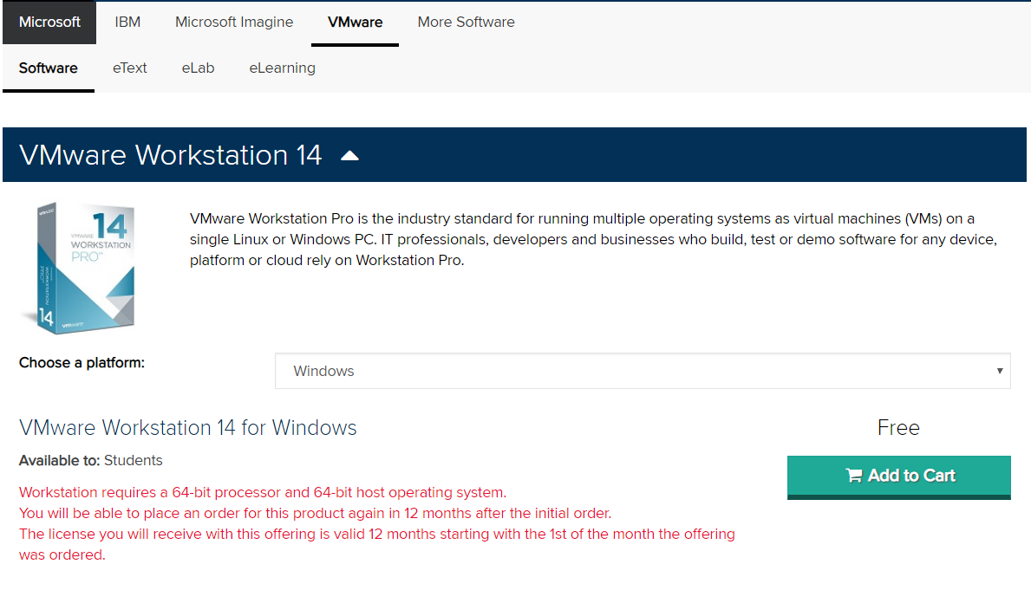
STEP 1
Download
VMWARE PRO
FROM STUDENT HUB
Download VMWare Pro from Sheridan Student Hub.

Slide 3
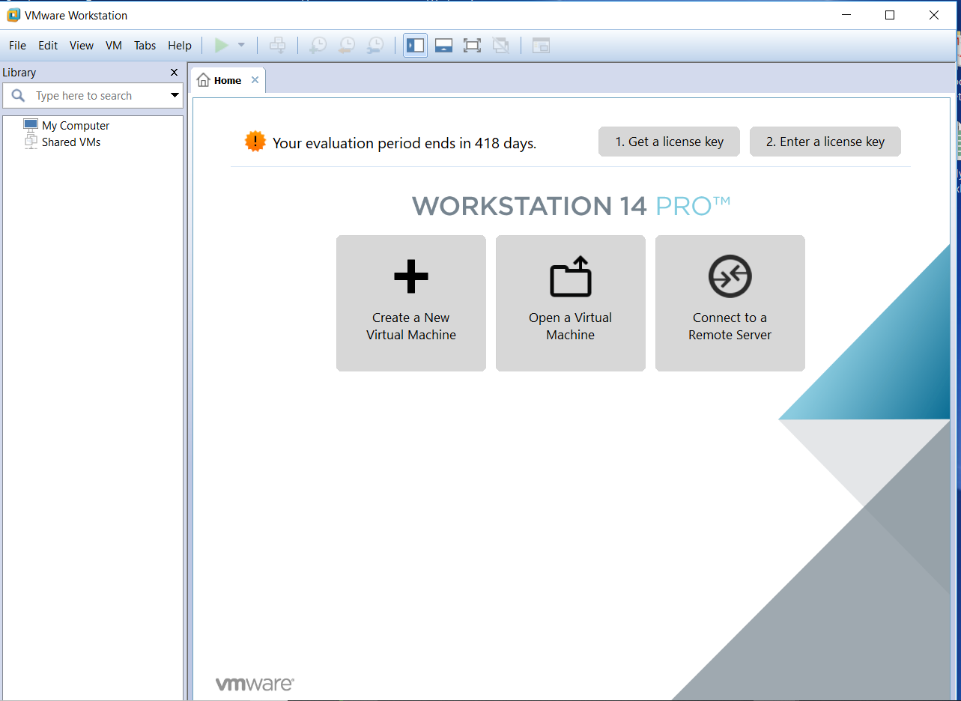
Step 2: Successful Downloading
Steps
Image
VMWare was installed on hardware.
After Successful completion open VMWare Pro.
Window with Title VMWare Workstation will display like image on right hand side.

Slide 4

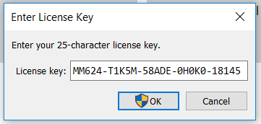
Step 3
Step
Image
Enter License Key on top bar of VMWare Pro
Note: Asterik shows the write where we will enter license key.
Enter a License Key

Slide 5
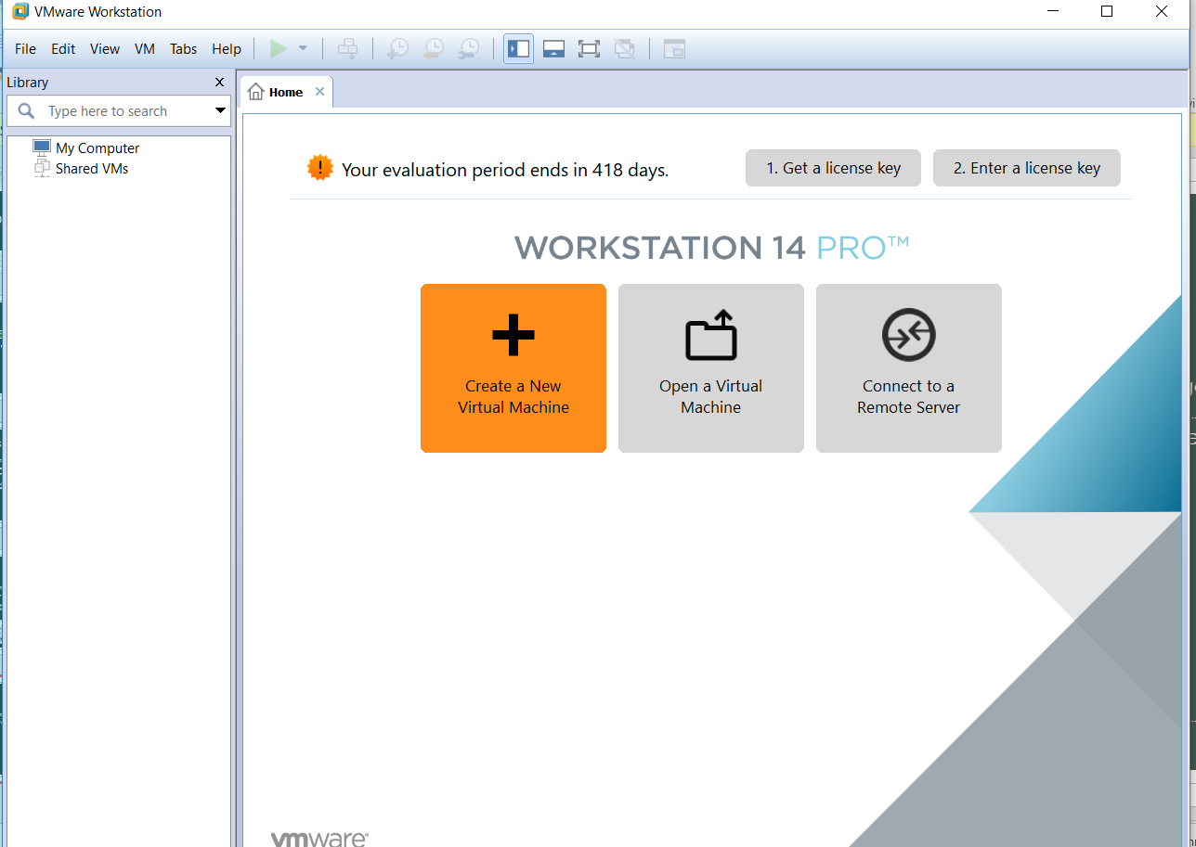
Step 4
Step
Image
Now Create a New Virtual Machine by clicking on plus sign first icon with title Create a New Virtual Machine.

Slide 6
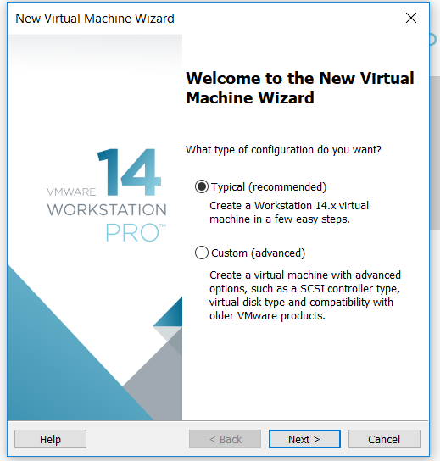
Step 5
Step
Image
Upon click a new window opens where click on Typical ( recommended).
Then click Next.

Slide 7
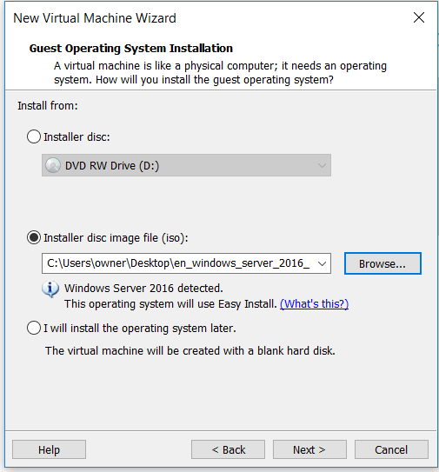
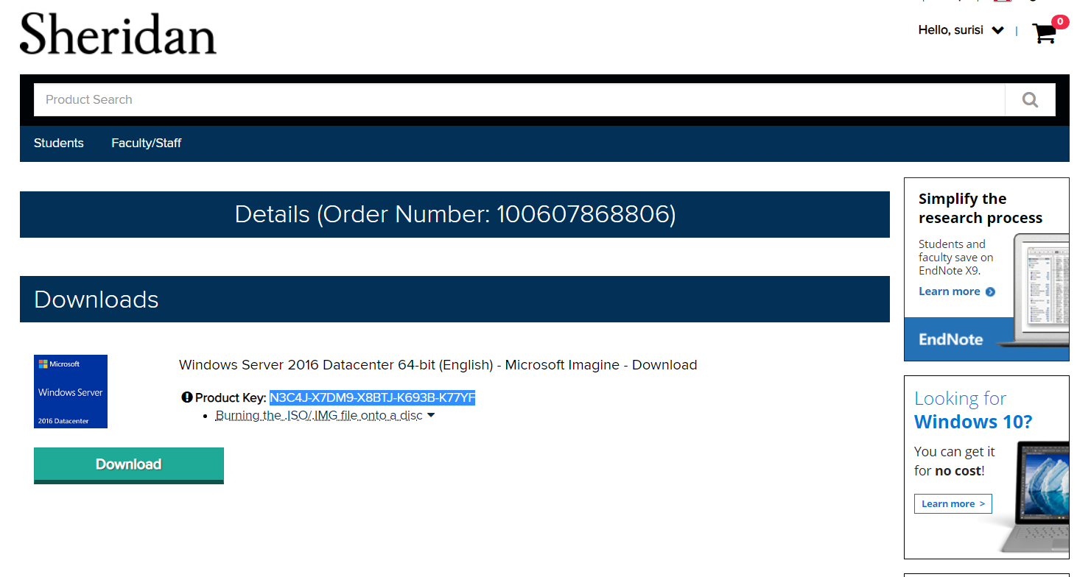
Step 6
Image
Step
Click on Installer disc image file(iso)
Then select file windows_server_2016 downloaded from Student Hub.

Slide 8
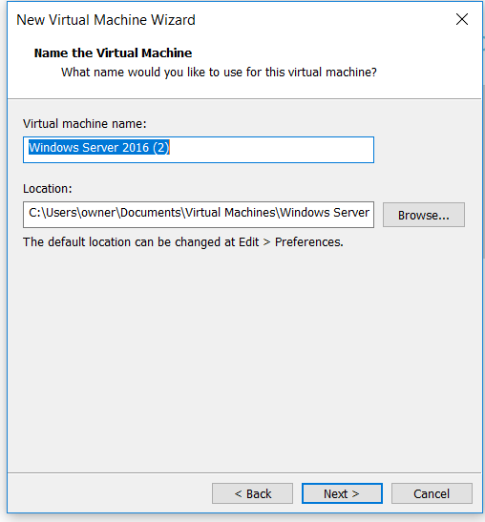
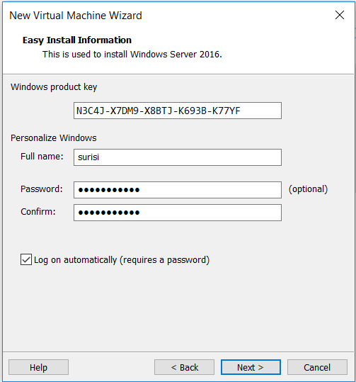
Step 7
Step
Image

Slide 9
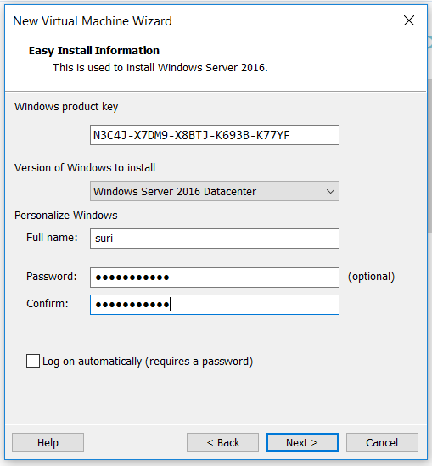
Step 8
Step
Image
Enter product key in new virtual machine wizard from Student Hub
Create full name and password
Click next

Slide 10
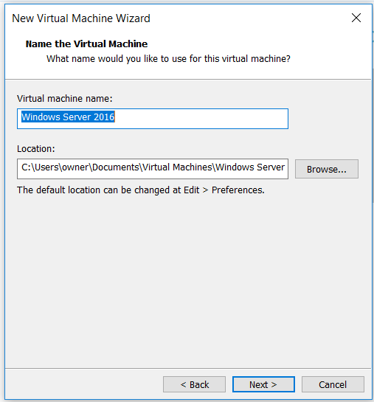
Step 9
Step
Image
Enter name of virtual machine : eg. Windows Server 2016

Slide 11
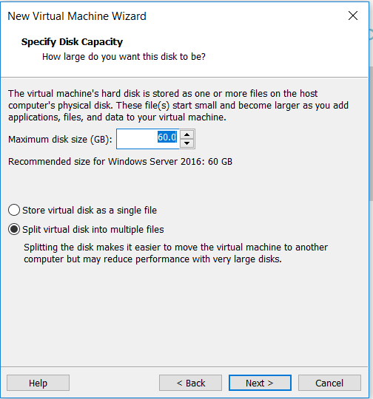
Step 10
Step
Image
Now Select Maximum disk size 60 GB.
Then create split virtual disk into multiple files.
Then click next.

Slide 12
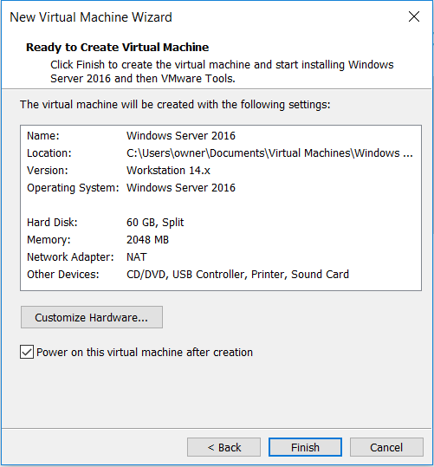
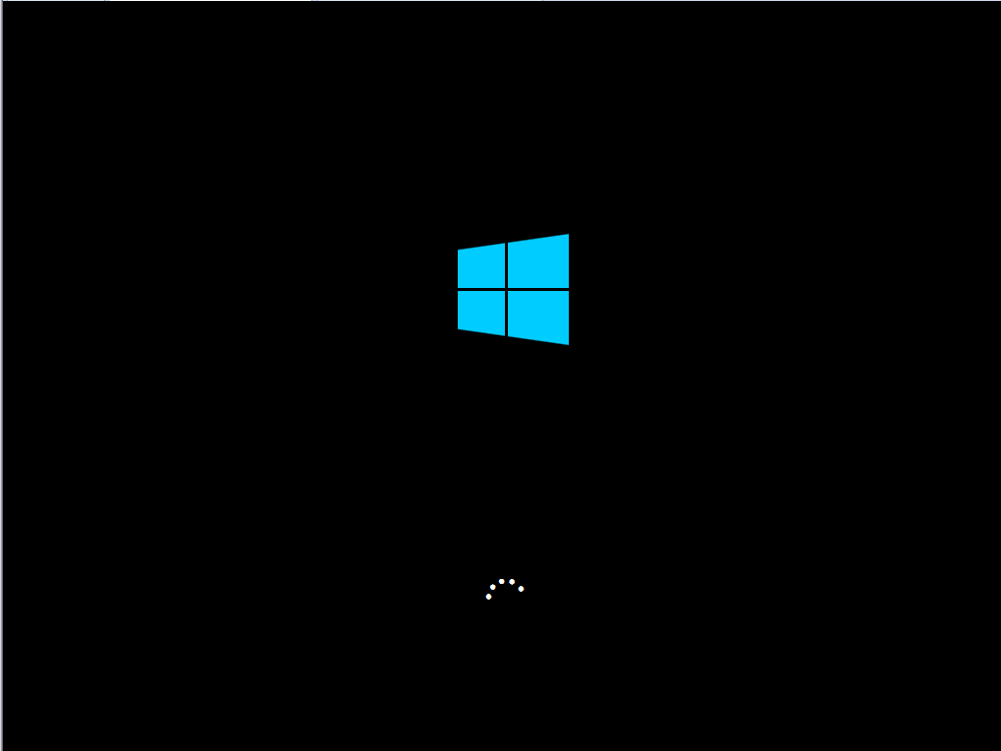
Step 11
Now, click finish and VMWare will download Windows Server 2016 .
Windows sign indicates downloading of Windows Server 2016.

Slide 13
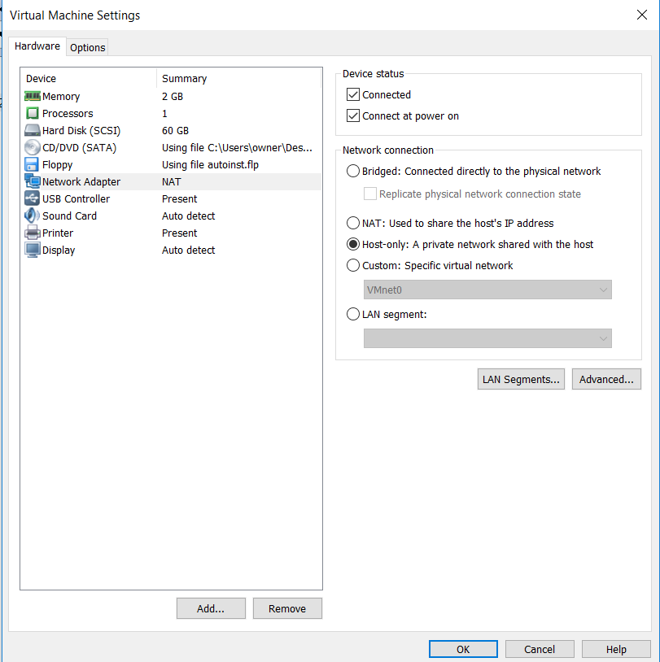
Step 12
Image
Step
Now go to Home and select First Windows and change settings to following :
Select Memory : 2GB
Hard Disk(SCSI) : 60 GB
Network Adapter : Host Only
Click Ok

Slide 14
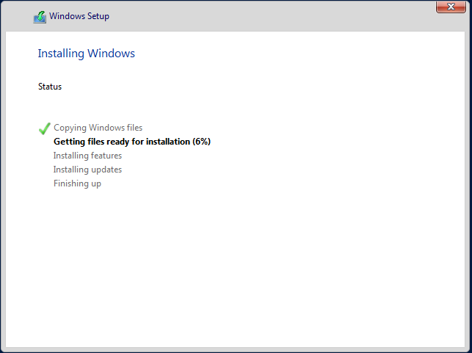
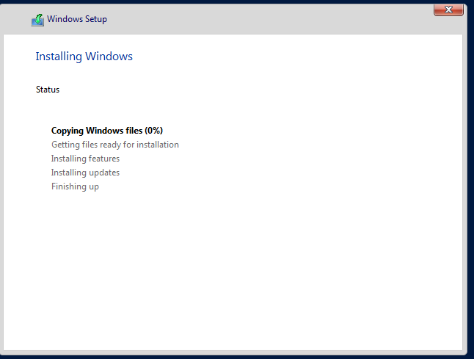
Step 13
Check Installation of Windows
Image

Slide 15
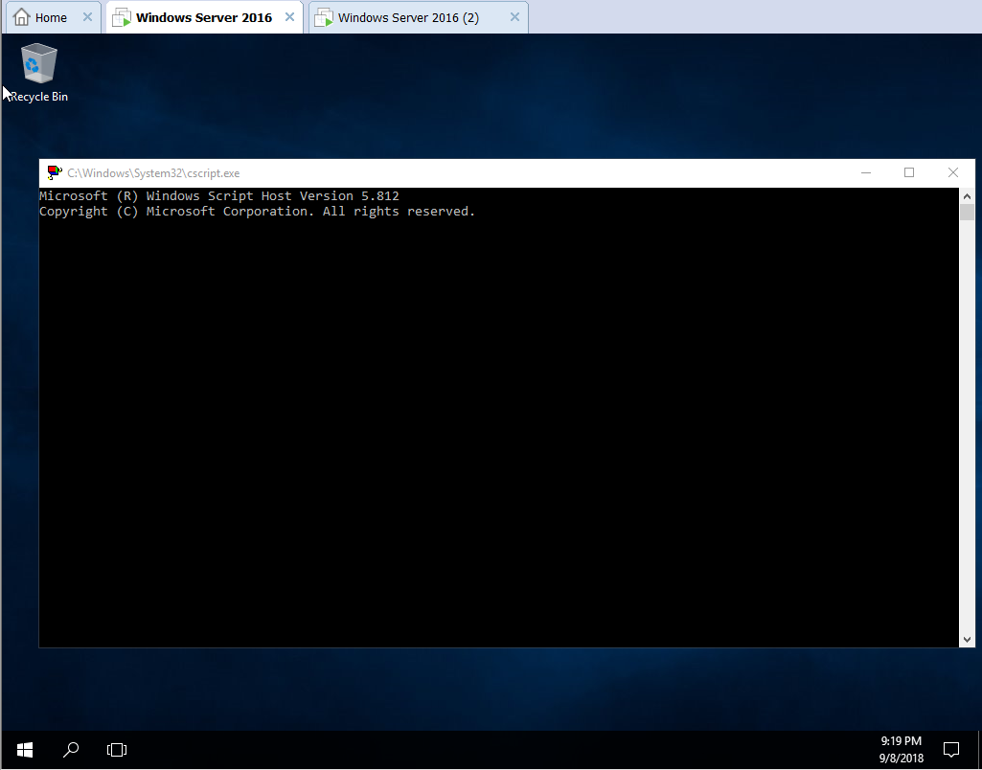
Step 14
Step
Image
This shows Windows installation is complete.
Now after this follow same steps and create second Virtual machine.

Slide 16
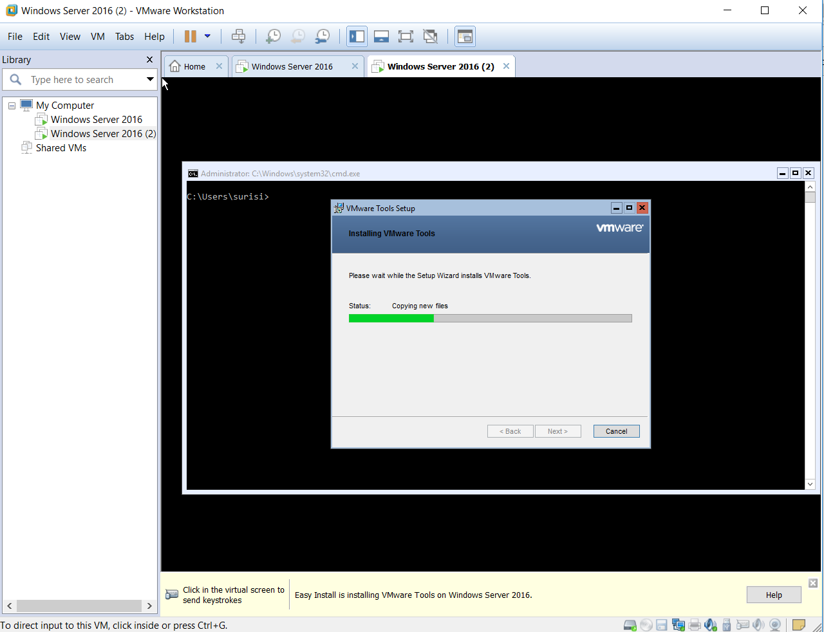
Step 15
Step
Image
After copying files VMWare will install VMWare Tools .

Slide 17
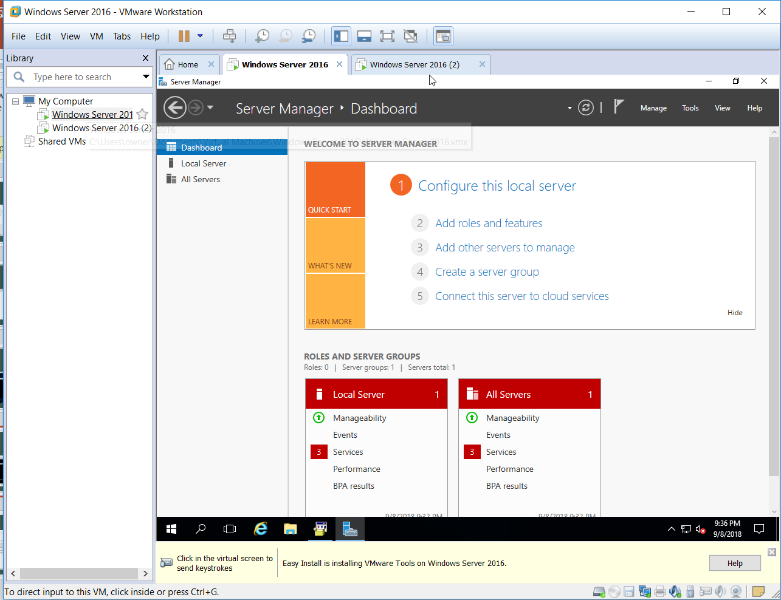
Step 16
Steps
Image
On Left hand bar it shows two virtual windows are created.
On right hand bar it shows Dashboard, local server and all servers.

Slide 18
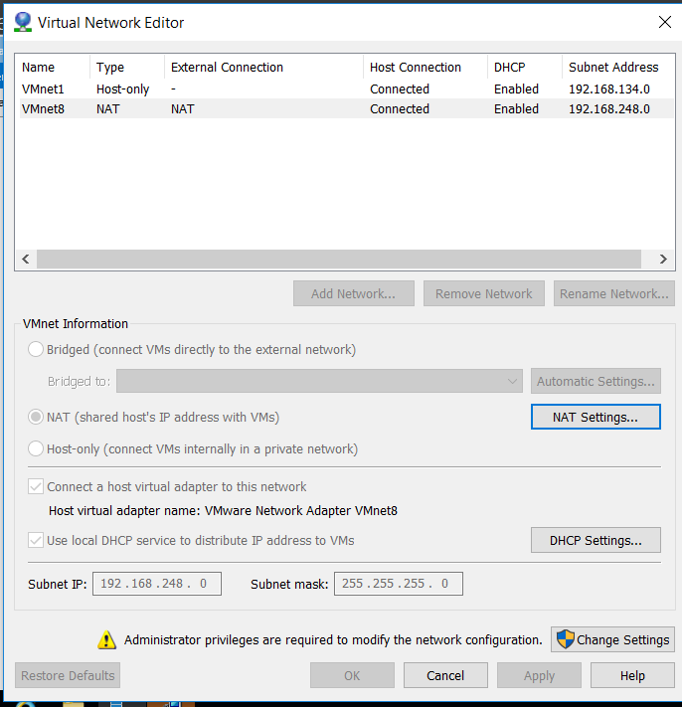
Step 17
Step
Image
Enable both virtual machines to host-only settings .
If any virtual machine is on NAT we can switch to host only.

Slide 19
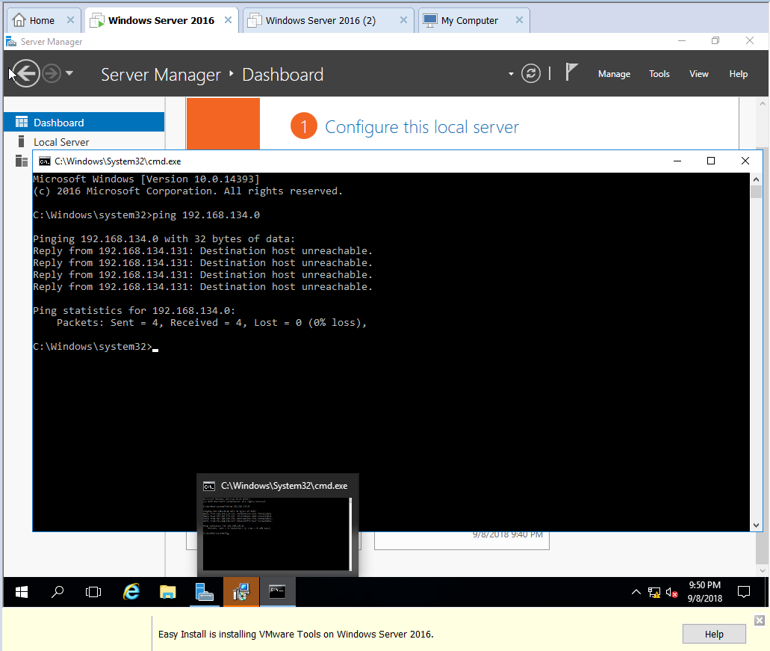
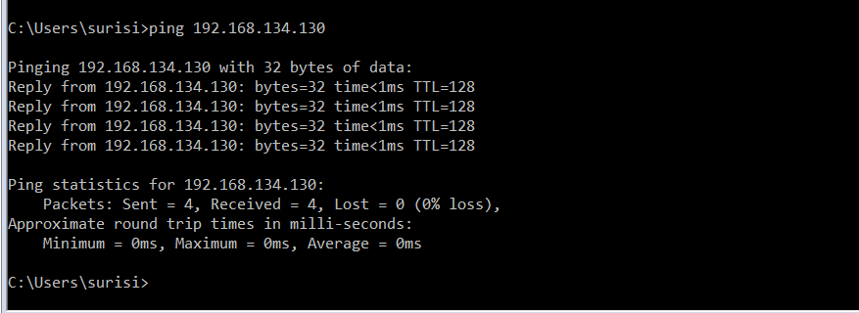
Step 18
Step
Image
Ping both virtual machines with their relative IP address .

